Slide 1



TransferIQ
Dynamic Player Transfer Value Prediction using AI & Multi-source Data
AI-Driven Forecasting of Football Player Market Values
Presented by: Himanshu Saxena
OCTOBER 2025
Git Hub Link

Slide 2
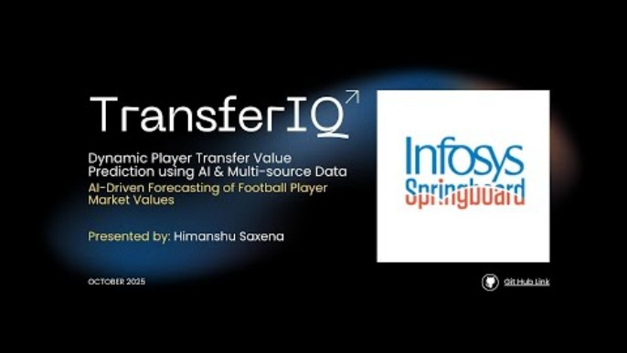
TransferIQ Player Transfer Prediction: Demonstration

Slide 3
TABLE OF CONTENTS
01
Project Overview
06
Key Implementation Highlights
02
Data Sources
07
Model Comparisons
03
Methodology Overview
08
Impact & Scope
04
Data Processing Pipeline
09
References
05
Model Development

Slide 4

PROJECT OVERVIEW
TransferIQ: A platform that unifies on-field performance, injury status, social sentiment, and market data to predict dynamic transfer values using advanced machine learning models.
The Problem:
Player transfer valuation is a multi-factor, dynamic, and high-impact decision area in professional sports.
Current market values rely heavily on manual scouting and subjective assessment.
TransferIQ introduces a data-driven, AI-powered forecasting system combining performance, sentiment, injury, and historical data.
Goal: Predict player transfer values with high accuracy using multi-source data and AI models.

Slide 5



DATA SOURCES
01
Performance Data
02
Market Data
03
Injury & Availability
04
Sentiment Signals
StatsBomb Open Data (events, lineups, matches) provided 3,464 event files, enabling robust feature engineering of per-90 metrics.
Transfermarkt values scraped across 11 major competitions, processing data for over 1,550 unique players, providing the target variable.
Curated injury data, complemented by Transfermarkt injury logs, rescraped and normalized to define critical player availability signals.
Reddit data, collected using web scraping, scored using TextBlob, aggregated to capture market and fan perception impacting value.

Slide 6



METHODOLOGY OVERVIEW
Data Collection and Processing:
Data is scraped, loaded, and stored in MySQL, providing a normalized foundation for players, clubs, and historic values.
Feature Creation:
Creation of performance per-90, trend features, injury signals, contract proxies, and aggregated sentiment scores.
Model Stack:
Univariate LSTM for baseline forecasting [Historic Market Values]
Multivariate LSTM (Encoder–Decoder) for multi-step prediction
XGBoost Ensemble for refined accuracy
Integration & Visualization:
Streamlit dashboard for interactive results.
User interface for real-time predictions, comparative analysis, and hyperparameter optimisation

Slide 7

DATA PROCESSING PIPELINE
Data collection → Cleaning → Feature engineering → Sentiment analysis → Database integration
MySQL used for unified querying and feature merging
Over 12 million rows processed from StatsBomb
Over 1500 unique players scraped from Trasnfermarkt for historic market data.
Performance Metrics:
Creation of per-90 metrics (e.g., shots, pressures, passes) derived directly from event-level StatsBomb data, capturing form and work rate.
Injury Data:
Metrics like “Total Injuries”, “Avg. Days Out”, and “Days Since Last Injury” provide critical signals on player durability and risk
Sentiment Aggregation:
TextBlob sentiment scores aggregated to capture the evolving public perception of a player, a key market driver.

Slide 8



MODEL DEVELOPMENT
Univariate LSTM:
Establishes the temporal baseline, focusing solely on historical market value trends, stabilized via seeded initialization.
Multivariate LSTM (11 Parameters):
Significantly improves error and stability by incorporating external factors like injury status, sentiment, and workload metrics. The model uses: Current Market Value, Historic Market Values, Total Injuries, Sentiment Mean, Avg Cards Per Match, Avg Days Out, Recent Injury, Days Since Last Injury, Minutes Played, Shots Per90 and Pressures Per90 as extensive list of parameters.
Encoder-Decoder LSTM:
Enables multi-step recursive forecasts per player, vital for long-term squad planning and negotiation preparation.
Ensemble (Seq2Seq LSTM + XGBoost)
Final layer where XGBoost learns over LSTM features and residuals, delivering calibrated, low-error final predictions.

Slide 9




KEY IMPLEMENTATION HIGHLIGHTS
We frame the valuation challenge as a time-series forecasting problem, utilizing multi-step horizons for forward guidance.
Time Series Framing
Multivariate Inputs
Target Forecasting
Each player's value history is modeled as a time series, using rolling windows to capture both recent form and long-term trends.
nputs include injury flags (days_out, recent_injury), sentiment mean, contract proxy, and performance metrics like shots_per90 and pressures_per90.
The model targets the next-window market value, employing a seq2seq approach for 3-step recursive forecasts, which are inverse-transformed to final €-million predictions.

Slide 10
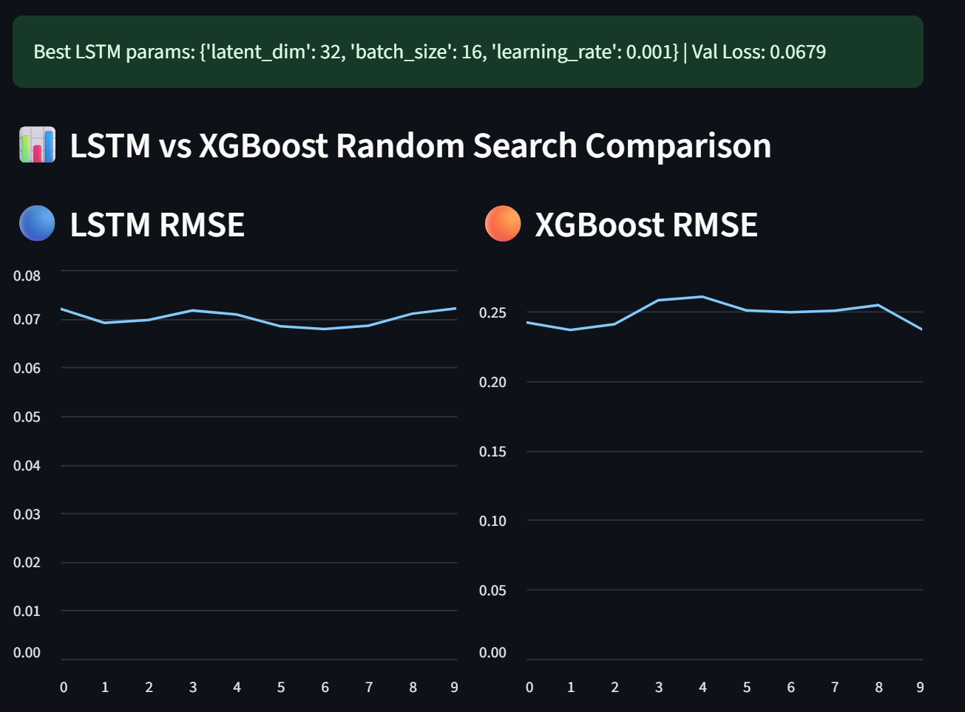
MODEL COMPARISONS

Slide 11
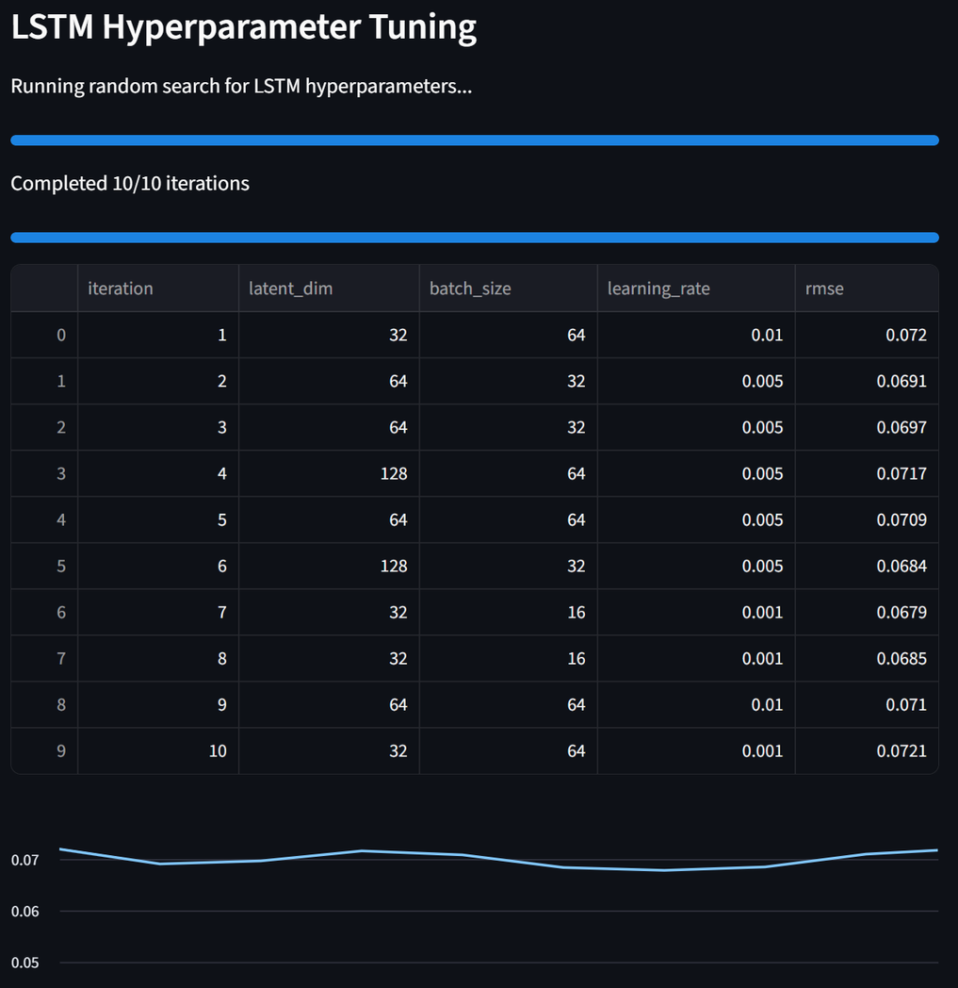
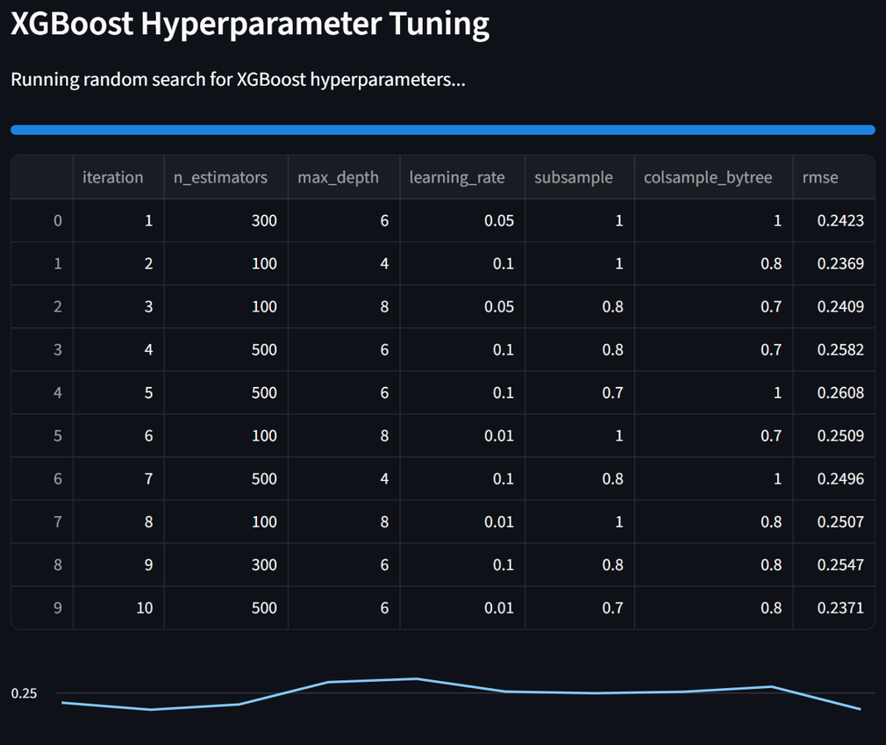
MODEL COMPARISONS - HYPER PARAM. TUNING
https://hpt-test.streamlit.app

Slide 12
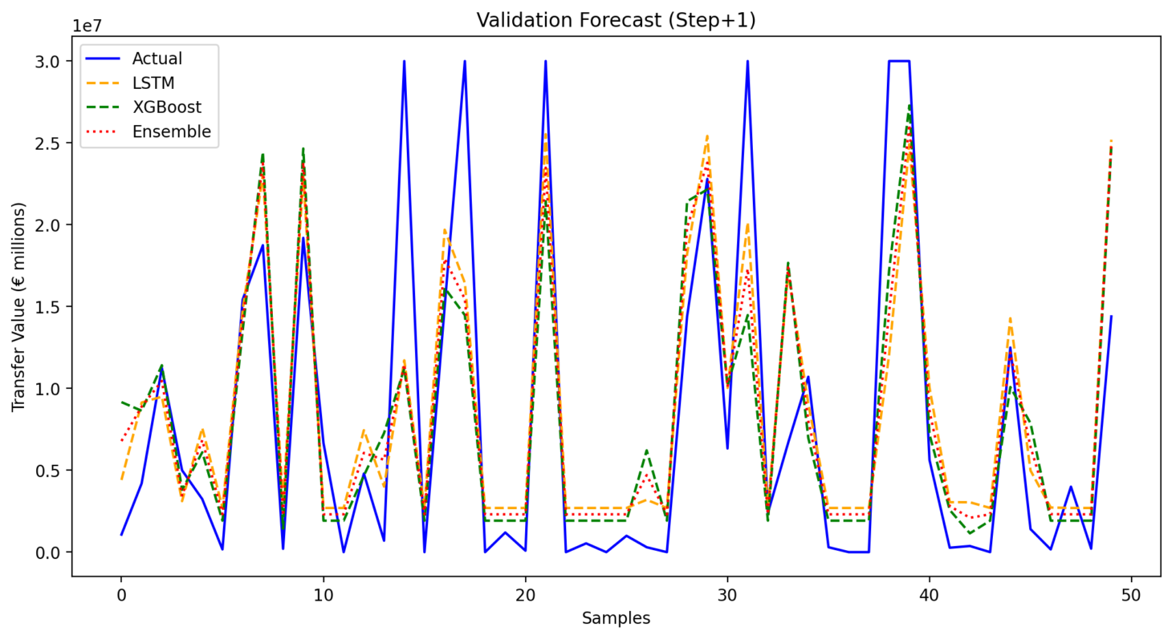
MODEL COMPARISONS

Slide 13
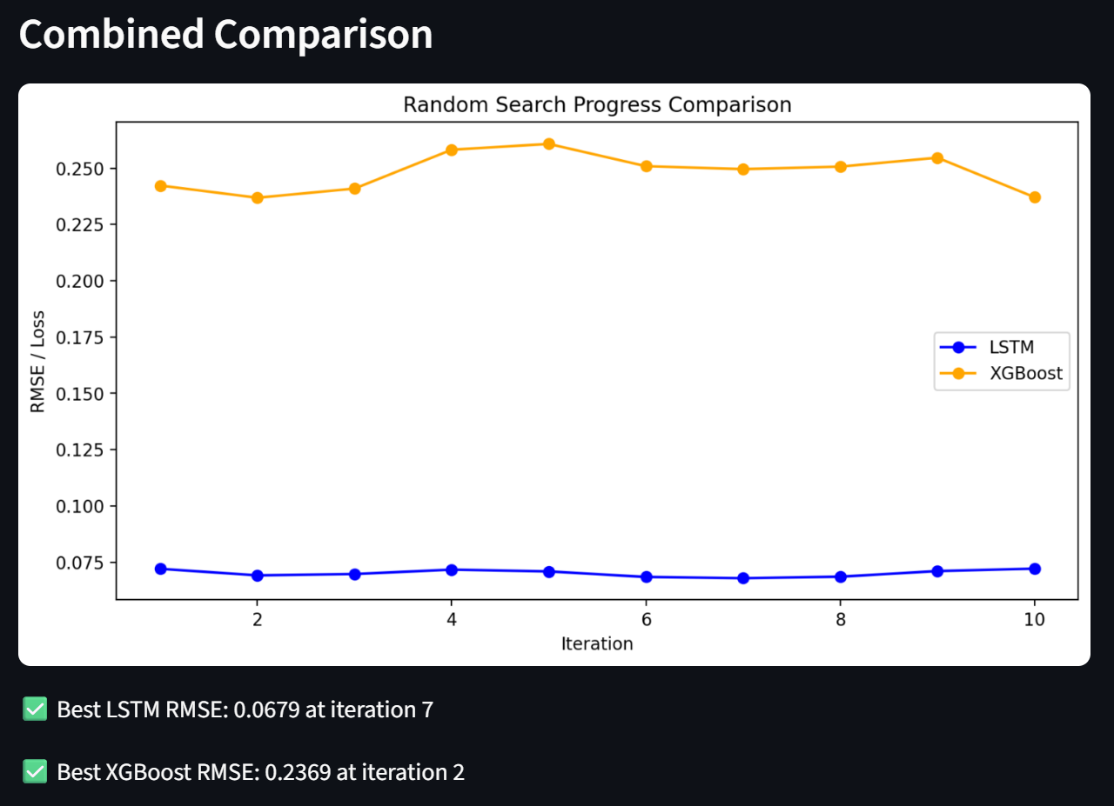
MODEL COMPARISONS

Slide 14
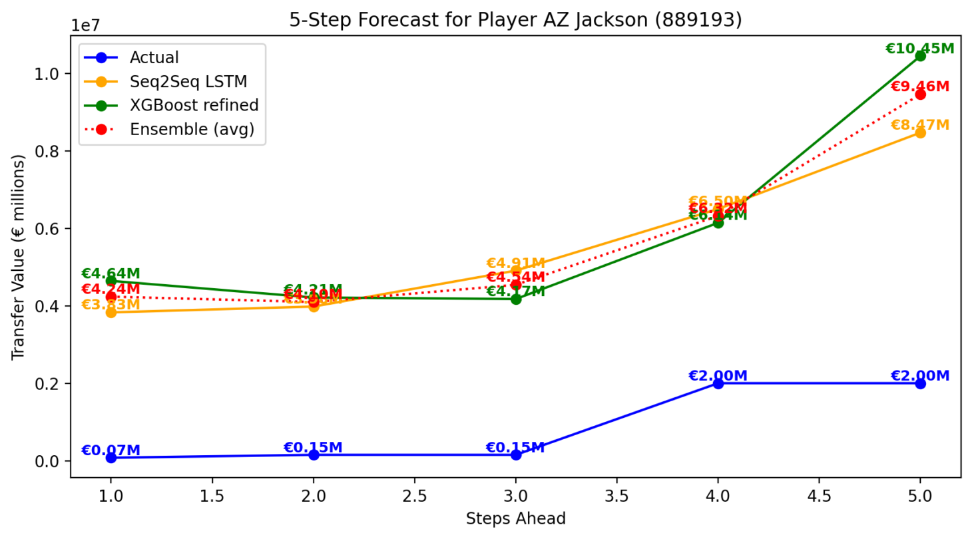
MODEL COMPARISONS

Slide 15



IMPACT AND SCOPE
DRIVING STRATEGIC DECISIONS
TransferIQ moves beyond simple prediction, serving as a critical decision-support tool across the football club's hierarchy.
Scouting Optimization:
Identify potentially undervalued assets and risk-adjust targets by factoring in injury frequency and negative sentiment trajectories.
Negotiation Leverage:
Enter negotiations with evidence-backed valuation ranges, understanding the key feature drivers (performance vs. sentiment) influencing the price.
Squad Portfolio Planning:
Utilize multi-window forecasts (3-step) for proactive squad value management, identifying optimal timing for player sales and recruitment.

Slide 16

REFERENCES
MATCH STATISTICS:
STATSBOMB GIT HUB REPO
PLAYERS LIST:
TRANSFERMARKET COMPETITIONS
HISTORIC MARKET VALUES:
TRANSFERMARKT HISTORY
PLAYER INJURY DATA:
TRANSFERMARKT INJURY HISTORY
PLAYER SENTIMENTS:
REDDIT DISCUSISIONS
PROJECT CODE:
GIT HUB REPOSITORY

Slide 17



